Slide 1
Electric Ireland Data Lake

Slide 2
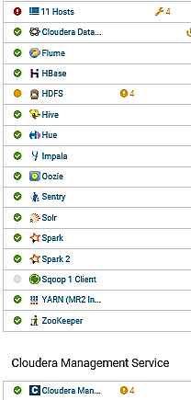
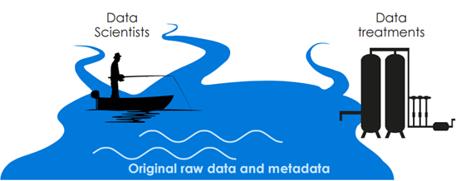
Overview of Electric Ireland Data Lake
EI Data Lake is a system or repository of enterprise data including raw copies of source system data and transformed data used for tasks such as reporting, visualization, analytics and machine learning.
Structured data from relational databases such as CMDM, BBM, Residential Portal, SAP DS, SES, Weather Portals, and so on.
Semi-structured data such as XML from Smart PayG
Unstructured data such as emails and binary data such as audio files
Hadoop Eco-System

Slide 3
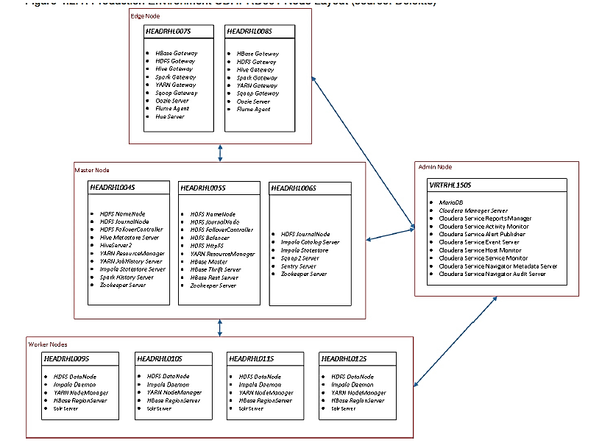
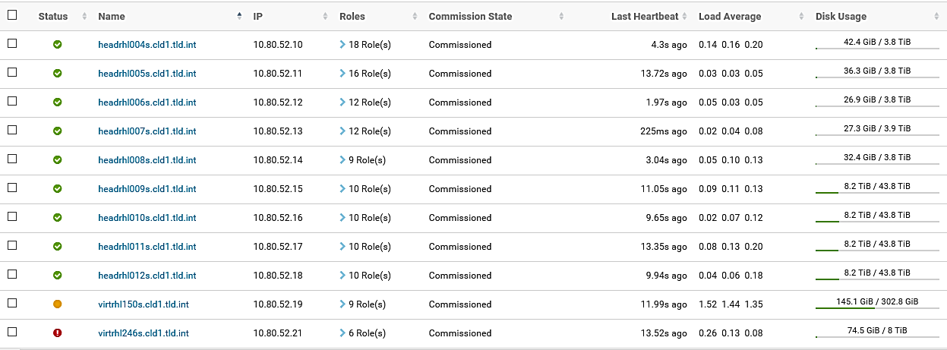
Infrastructure of Electric Ireland Data Lake Environment

Slide 4


Architecture of Data Lake
Customer Solutions Visualization/Reporting
Data Analytics/Modelling
Security
Applications &
Spreadsheets
Visualization & Intelligence
AD
AD
KDC
AD
Cloudera Data science
Workbench(CDSW)
ODS/360 Customer & Datamarts
Enterprise Data Hub (CDH 5.15.1)
Hive
Impala
HBase (NoSql)
Avro/ Parquet
Hcatalog( Storage Management)
MapReduce/Spark (Processing & Transformation)
HDFS(Storage)
Security & Administration ( Yarn, Cloudera Manager, Navigator, Sentry)
Sqoop/NiFi (Ingestion)
RDBMS
Other Data Sources
CMDM/
SSIS
Residential Portal
BBS
Front Office
SAP
(IRP/SRP/CRP/SAP BW)
ABTRAN,
LIBERTY,
SIEMENS
SMARTPAYG
NETWORKS
External Sources thru API (Cylon, Weather, Trustpilot)
SEMOPX
ESB Trading
DMZ

Slide 5
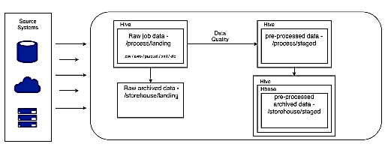
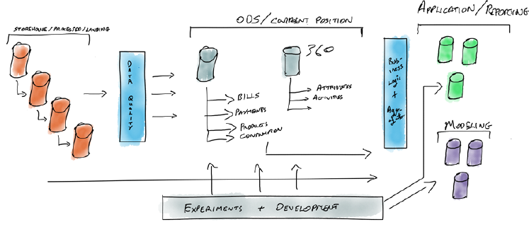
Contd..
Overall Data Flow
Sources for the Lake feed HDFS which are then cleaned, transformed using Spark process and ready to be loaded further into Hive, HBase and Impala tables for use by Data Analysts and Data Scientists.
Data Layers in the Lake
Layer 1: Process (Incremental) / Storehouse (History) of Raw Data
Layer 2: ODS/360Customer (Current, Cleaned and Transformed Data)
Layer 3: Application / Reporting ( Data as per specific Business Needs like CM, BrkrMgmt, Smarter Homes)

Slide 6
Data Lake Hadoop components’ role
Component | Description | Role in EI
HDFS | Hadoop High Availability (HA) distributed file system | Storage of Structured, Semi structured, unstructured data
Map Reduce/YARN | Hadoop parallel computing engine | Fast parallel processing for batch application
HBase | The Hadoop NoSQL database | Store attribute data like customer data to keep it up-date as in source system
Sqoop | Tool designed for efficiently transferring bulk data between Apache Hadoop and structured data stores such as relational databases | Sync Hadoop and RDBMS data
Hive | Mature SQL engine for writing parallel jobs via SQL like language | Historical / Incremental data insertion, to create data marts
Impala | High volume parallel processing (MPP) SQL query engine Provides real time data discovery on Hadoop | Ad Hoc real time queries
Spark |  | Used to share schemas between Hive and Impala
Hcatalog | Shared metastore (for SQL metadata) for all the Hadoop query components | Used to share schemas between Hive and Impala
SOLR | The popular, fast open source enterprise search platform from Apache Lucene. Useful for very unstructured data | information Management Search – Metadata
HCatalog | Shared metastore (for SQL metadata) for all the Hadoop query components | Used to share schemas between Hive and Impala
Zookeeper | distributed configuration service, synchronization service, and naming registry | Co-ordination between all other Hadoop Services

Slide 7


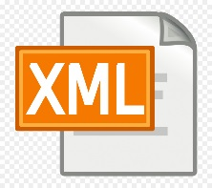







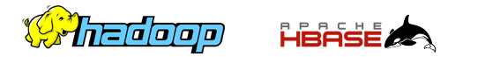
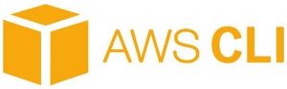
Sources of the Data Lake
Traditional Relational Database
Flat Files
Semi-Structured Files
Cylon
Webchat
Trustpilot
CMDM
Residential Portal
BBS (Trading DB)
ESB Trading
Informix
Front Office
SAP (SRP, IRP, CRP, SAP BW)
ABTRAN
SES
LIBERTY
SIEMENS
SNIPP
SMARTPAYG
NETWORKS
BROKER SOA
GEO DIRECTORY
SALESLEADS
WEATHER DATA
RISK
Smart PayG Profile values
Unstructured Files
Call recordings
Cloud Sources

Slide 8
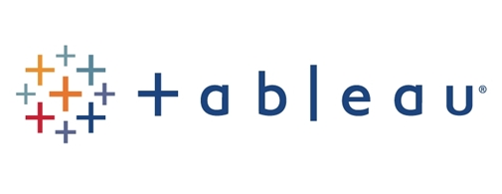
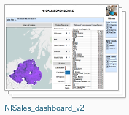
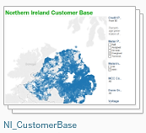

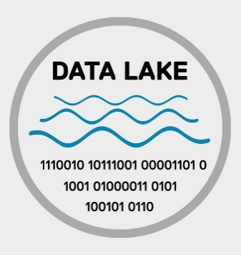

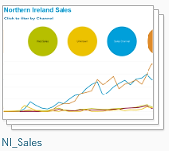
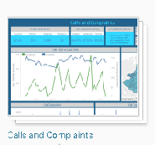


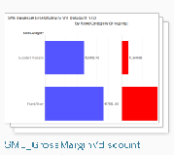
Applications of the Data Lake – Dash Boards / Reports
Broker Management

Slide 9
Use Cases – Data Engineering
Real-time streaming analytics platform : Deployed open source analytics platform tool called Cloudera Dataflows(NiFi). It's a scalable, real-time streaming analytics platform for ingesting data from different source system into Hadoop Data lake. Developed dataflows to ingest near real-time data for EI-Telephony Data for NI and CS in Cisco platform by processing the data before storing in Data Lake.
SAP Hybris Transition : Re-developed data models to use SAP data in place of CMDM(SQL) data in Lake. The daily data extraction from the SAP Hybris table will be FTP’d to Sap Marketing Cloud and this improved data quality and
reduces the lag time.
Email Analytics (NLP Implementation) : Sentiment Analysis over customer email conversation is to find out whether the customer is satisfied with EI/ESb services (positive, negative, or neutral) .This is achieved by categorising the customer email conversation into set of topic by using topic modelling algorithm.
Trust Pilot (NLP Implementation) : Customer feedback is a crucial source of information describing user experience with a company and its service. Web scraping reviews and related data from Trust Pilot site for ESB energy and other supplier’s data. Topic Modelling on the review data and Sentiment Analysis

Slide 10
Contd..
SES Energy Management : Developed Python scripts to integrate data ingestion by connecting to Cylon Active Energy APIs. The daily Energy data received will be processed to store in Lake which will be used later for Reporting/Dashboards by SES Team
Genesis API Integration : Developed Python scripts to integrate data ingestion from Genesis Cloud by connecting to Genesys Platform APIs . The weekly interaction aggregate call data for ESB energy stored in Lake tables

Slide 11

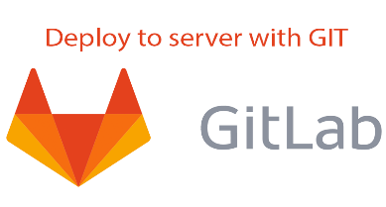
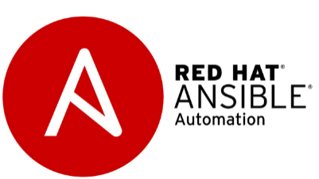

DevOps Integration in the Data Lake
Jenkins is a self-contained, open source automation server which can be used to automate all sorts of tasks related to building, testing, and delivering or deploying software.
From project planning and source code management to CI/CD and monitoring, GitLab is a single application for the entire DevOps lifecycle.
Ansible is open source software that automates software provisioning, configuration management, and application deployment. Ansible connects via SSH, remote PowerShell or via other remote APIs.
Maven is a build automation tool used primarily for Java projects. Maven addresses two aspects of building software: first, it describes how software is built, and second, it describes its dependencies.

Slide 12
END

